Slide 1
Sentiment Classification in Internet Memes: A Multimodal Study
Gandhar Ravindra Pansare
Saish Vasudev Mhatre
Tanmayee Tajane

Slide 2

Contents
Introduction
Significance
Approach
Model Details
Comparing Results
Conclusion

Slide 3
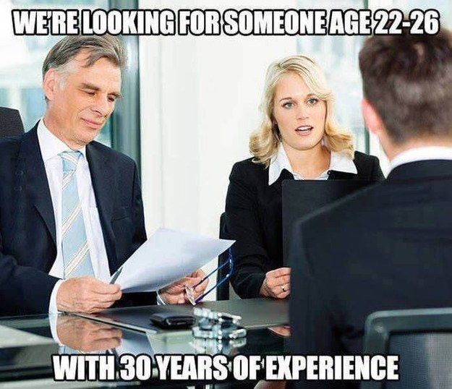
Introduction
Internet memes are a unique form of online expression that fuse images and text to convey humor, sarcasm, and cultural sentiments.
Analyzing the sentiments and emotions behind memes can provide valuable insights into online culture and behavior.
This has diverse applications in social media and marketing analysis, personalized recommendations, image classification models and more.

Slide 4
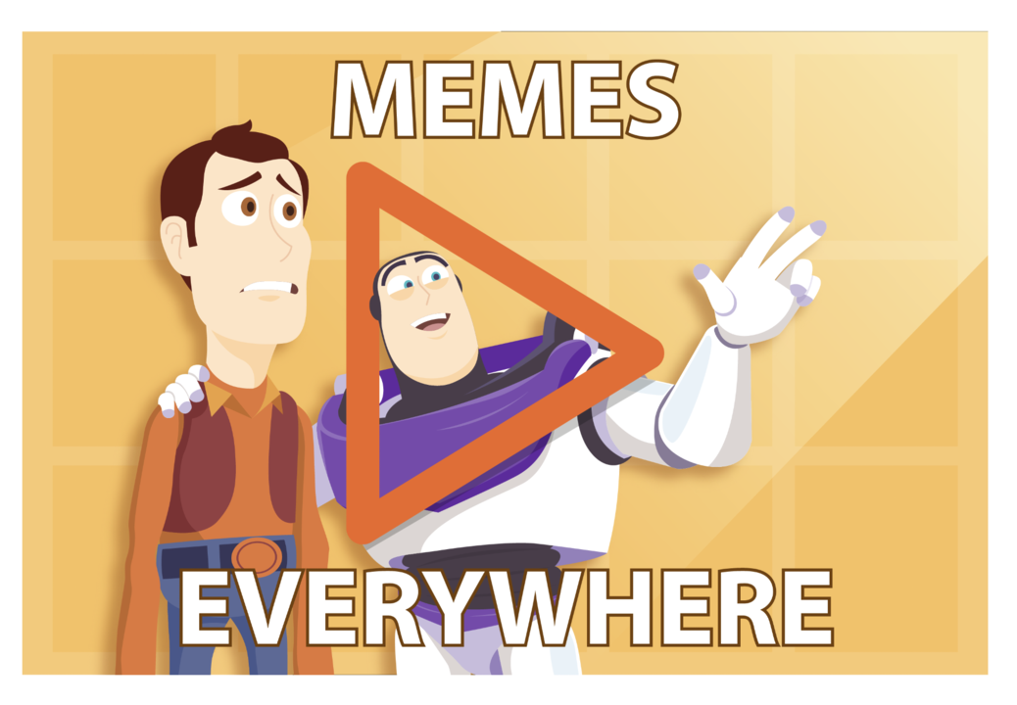
Significance
Meme sentiment analysis allows better understanding of how internet humor spreads virally.
Models can be extended to analyze sarcasm, culture and behavior from memetic content.
More personalized social media feeds, recommendations and ads based on user sentiments.

Slide 5
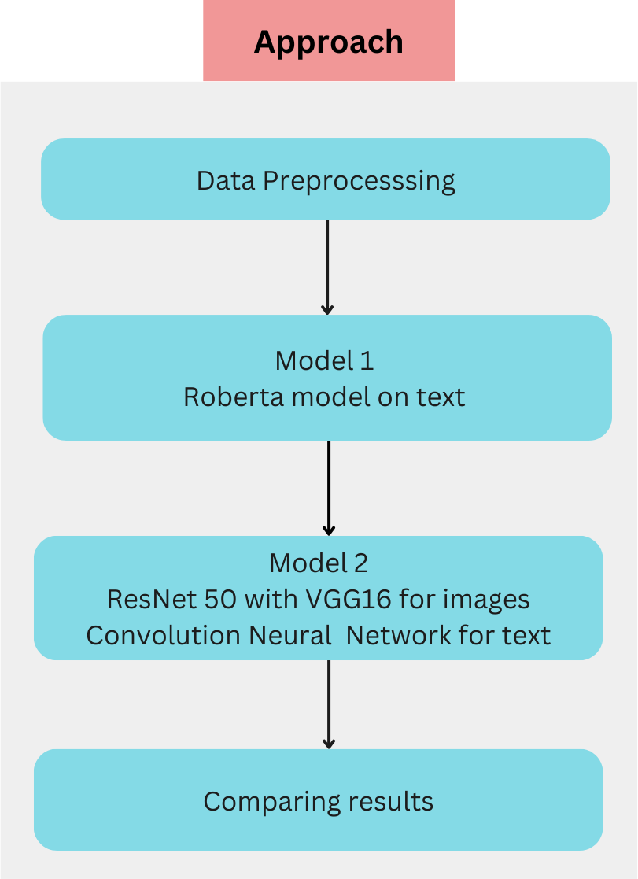
Approach

Slide 6

Data Preprocessing
The dataset contains 6992 image and text meme pairs.
Handled missing data
Identified and removed rows with NaNs
Encoded sentiment labels
Mapped text labels to numeric categories
Image preprocessing
Loaded images as arrays
Resized to 100 x 100 pixels
Normalized RGB pixel values
Text preprocessing
Converted all text to lowercase
Removed punctuation & numbers
Reduced vocabulary corpus size

Slide 7
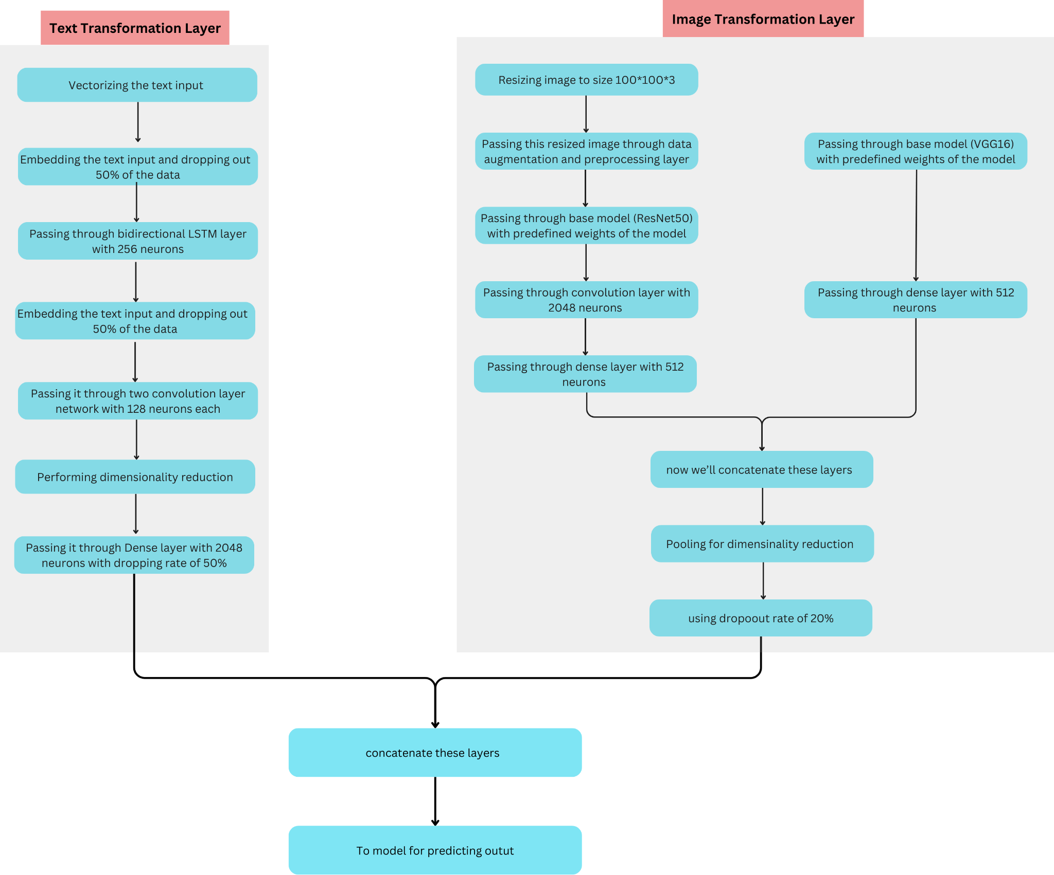
Model 2 - Overview

Slide 8
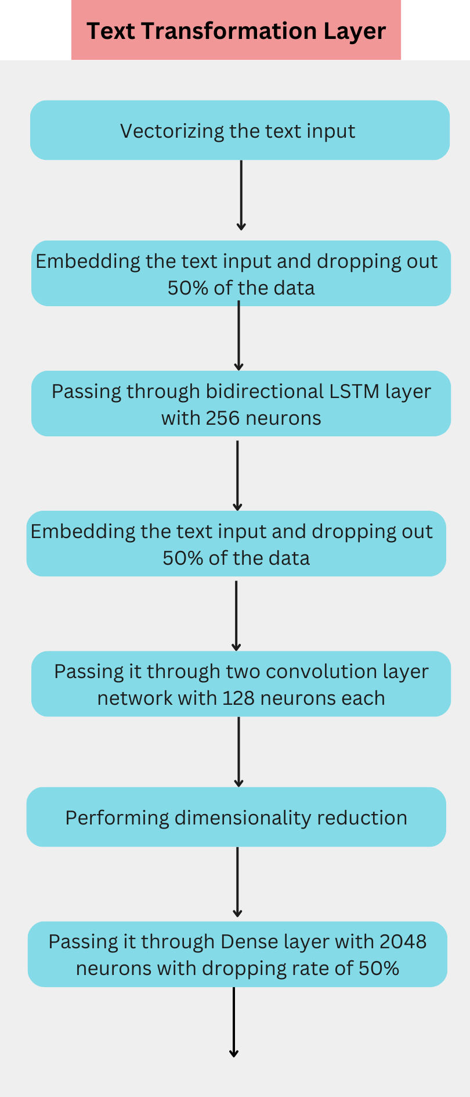
Model 2- Text Transformation Layer

Slide 9
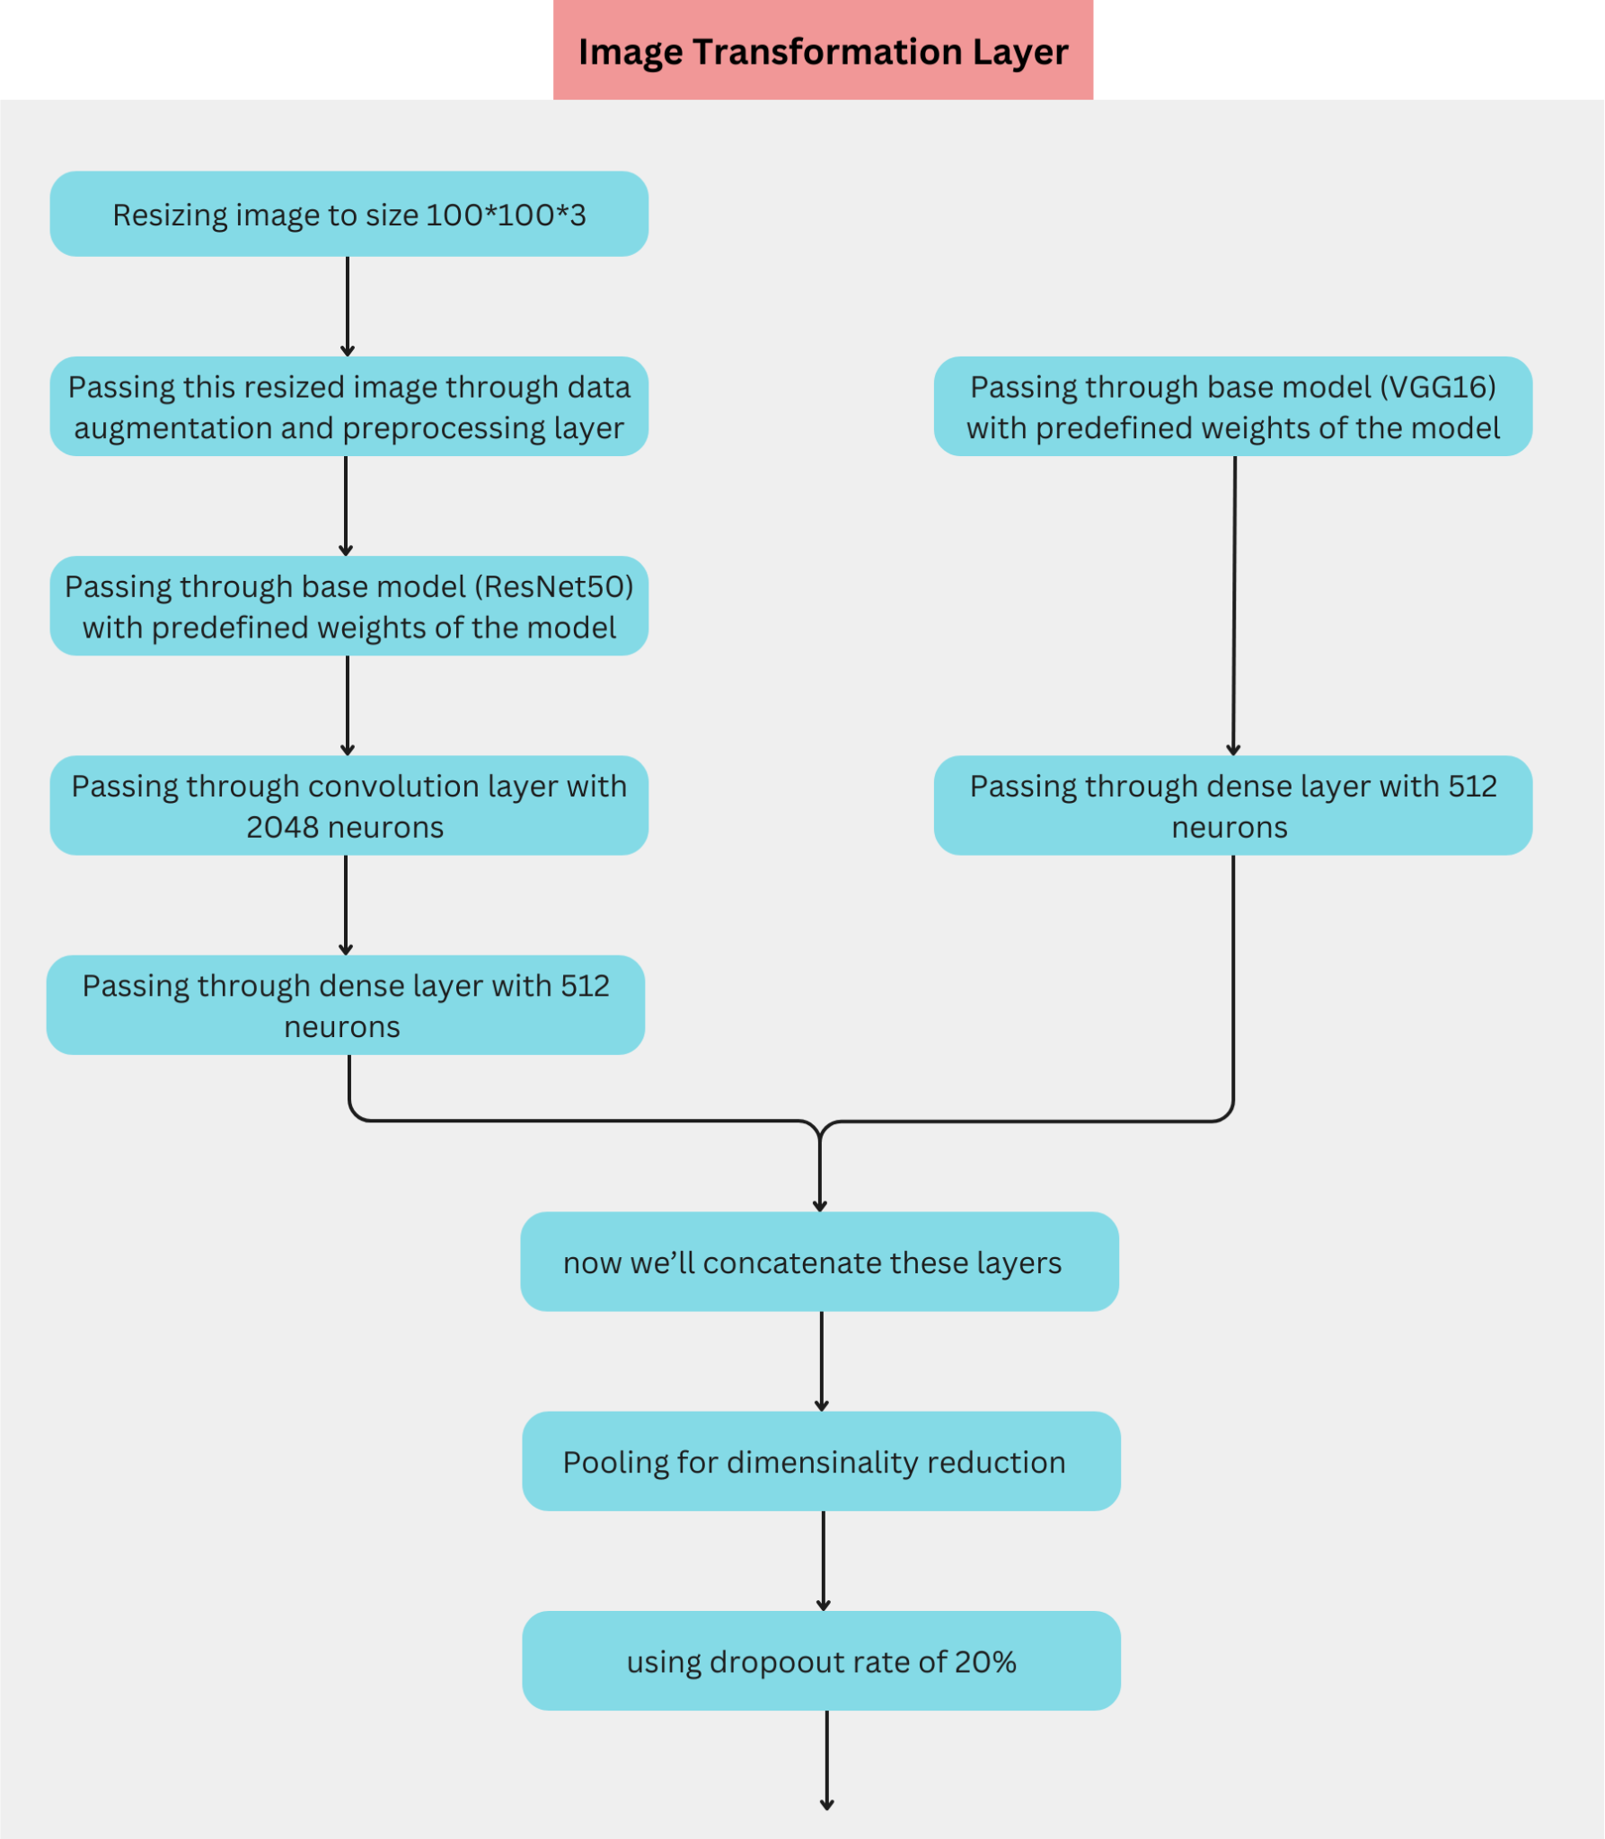
Model 2 - Image Transformation Layer

Slide 10
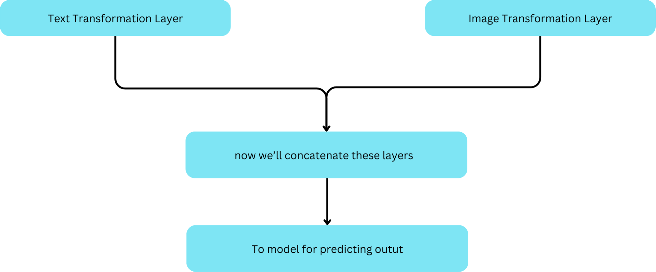
Model 2 - Concatenation Layer

Slide 11
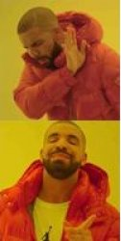
Comparing Results
Model 1 - Text-only:
Architecture: RoBERTa
Inputs: Meme text sequences
Accuracy: 25%
Model 2 - Multimodal:
Text features: 1D CNN
Image features: ResNet50, VGG16
Inputs: Text sequences & images
Accuracy: 45%

Slide 12

Conclusion
Multimodal model with combined text and visual features improves performance.
20% higher accuracy compared to text-only model.
Image context captures nuances that text alone misses.
Visual elements crucial for interpreting humour and sarcasm in memes.

Slide 13


